Slide 1
SVM and Bi-LSTM
Prof. Sebastián Vallejo Vera

Slide 2

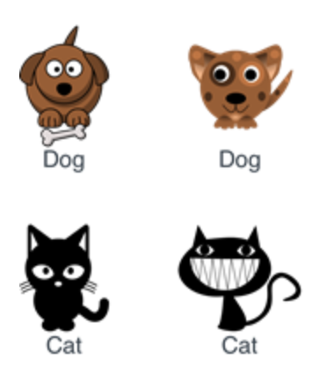
Labeled Data
Black Magic
Machine Learning Models
Prediction
It’s a dog!
or
It’s a cat!

Slide 3
SVM

Slide 4
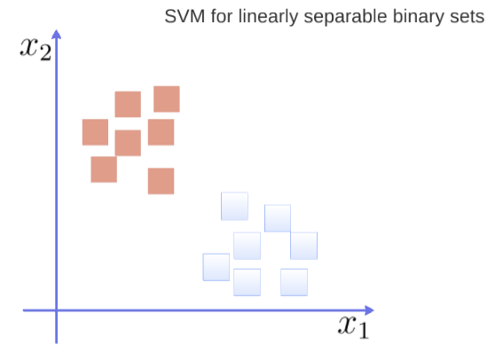

Slide 5
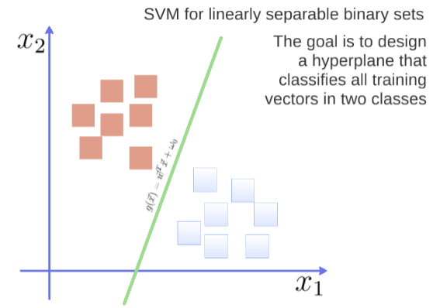

Slide 6
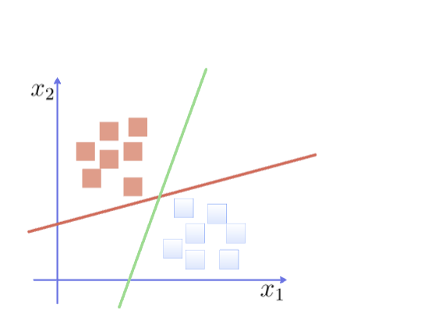

Slide 7
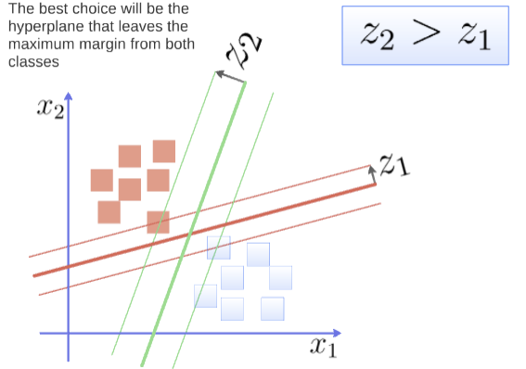

Slide 8
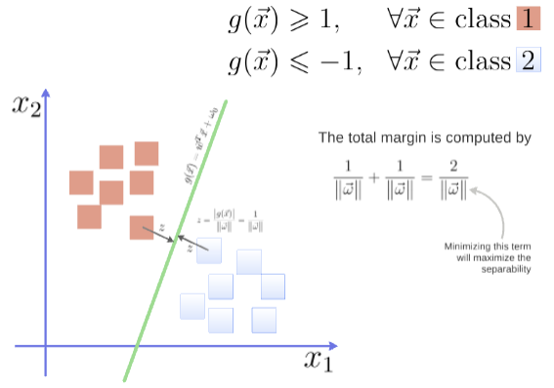
You can see the math at work here: https://www.youtube.com/watch?v=1NxnPkZM9bc

Slide 9
Ok, but what feature do we use in order to classify texts using SVM?
That’s right, word frequencies (e.g., TF-IDF).
And then we just choose a kernel function (i.e., a transformation of the data that allows you to process it more easily).

Slide 10
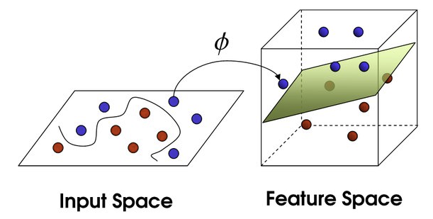
This is also called the kernel trick!

Slide 11
Ok, but what feature do we use in order to classify texts using SVM?
That’s right, word frequencies (e.g., TF-IDF).
And then we just choose a kernel function (i.e., a transformation of the data that allows you to process it more easily).
Now that we’ve done that, every text in our dataset is represented as a vector with N dimensions, each one representing the frequency of one of the words of the text. That’s SVM!

Slide 12
Bi-LSTM

Slide 13
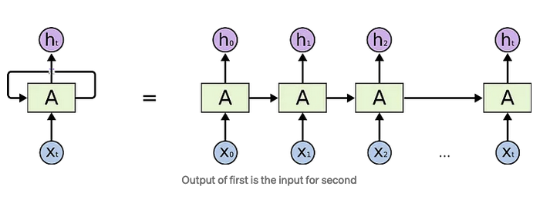
Recurrent Neural Networks - RNN

Slide 14
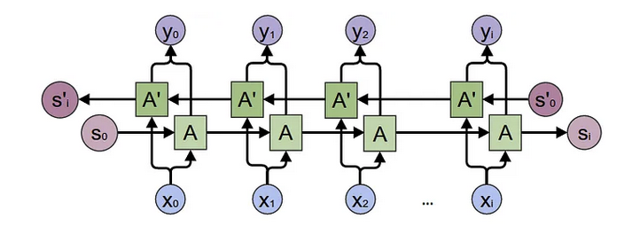
Bi-directional long short term memory
Bidirectional recurrent neural networks (RNN) are putting two independent RNNs together. This structure allows the networks to have both backward and forward information about the sequence at every time step.

Slide 15
The LSTM will use previous information (previous words) to predict the next word. The L(ong) in LSTM allows it to capture long-term dependencies in sequential data (e.g., sentences).
The Bi in Bi-LSTM, allows it to use both previous and future information.
But it also has gates that allow it to forget useless information, update it with useful information, and maintain if no changes are required.

Slide 16
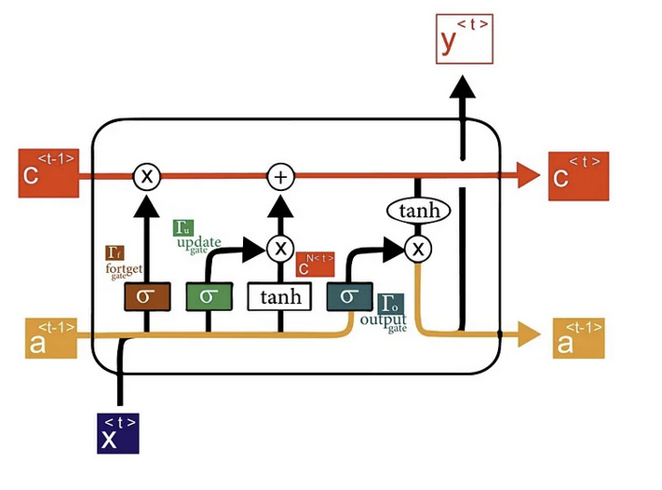

Slide 17
The benefit of Bi-LSTM is that it captures not only the context that comes before a specific time step (as in traditional RNNs) but also the context that follows. By considering both past and future information, Bi-LSTM can capture richer dependencies in the input sequence.
It takes the following architecture:

Slide 18
Input Sequence: The input sequence is a sequence of data points, such as words in a sentence or characters in a text. Each data point is typically represented as a vector or embedded representation.
Embedding: The input sequence is often transformed into dense vector representations called embeddings. Embeddings capture the semantic meaning of the data points and provide a more compact and meaningful representation for the subsequent layers (see Week 6)
Bi-LSTM: The Bi-LSTM layer is the core component of the architecture. It consists of two LSTM layers: one processing the input sequence in the forward direction and the other in the backward direction. Each LSTM layer has its own set of parameters.
Output: The output of the Bi-LSTM layer is the combination of the hidden states from both the forward and backward LSTM layers at each time step. The specific combination method can vary, such as concatenating the hidden states or applying a different transformation.

Slide 19
How can we use it? / Why should we care?
Once you have the output, you can add one final layer that is passed by a softmax activation to obtain class probabilities (more on softmax activation next week).
Bi-LSTM has been shown to outperform the other SML models studied so far (and dictionary-based approached). It is particularly powerful when combined with word embeddings.
The nice thing about Bi-LSTM is that it leaves behind the BoW approach. No more are we disregarding context. Now, we are using context to our advantage.
But if we could do this with an EVEN BETTER architecture?

